Slide 1
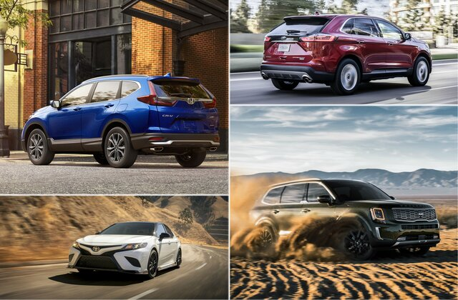
AUTOMOBILE SALES TREND IN THE USA An Excel Project By Sahinta Das

Slide 2
BUSINESS QUESTIONS
What is the car purchasing trend in the USA according to the annual income of the customers?
Which car company has the highest sales in top 5 region?
What are the top automobile companies?
What are the top body styles according to sales history?
What are the top car selling regions?
Who are the top automobile dealers in the USA?
What are the most selling body style of top 5 autombile companies?
What is the gender wise automobile spending trend?
How many customers have made repeat purchases from the same dealer?
What percentage of customers have purchased multiple cars?
11. What is the total sales revenue generated from car orders?
12. Which dealer has the highest sales revenue?
13. What is the average selling price of cars?
14. What is the distribution of annual income among customers?
15. How many cars are purchased by each gender?
16. Which customer has made the highest-priced purchase?
17. Which region has the highest number of car sales?
18. What is the average selling price of cars in each region?
19. How does the sales volume vary between different dealers?
20. Which car model is the most popular among customers?
21. What is the distribution of car colors among sales?
22. What is the most common engine type and transmission type among sold cars?
23. Is there a correlation between the price of cars and the annual income of customers?
24. Is there a correlation between customer loyalty and annual income?

Slide 3
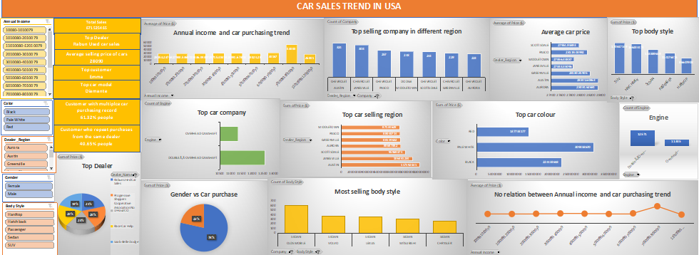

Slide 4
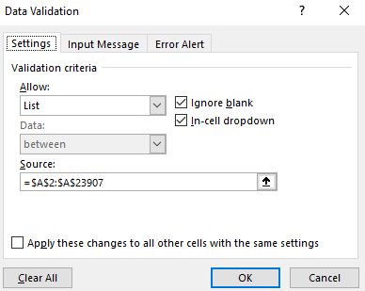
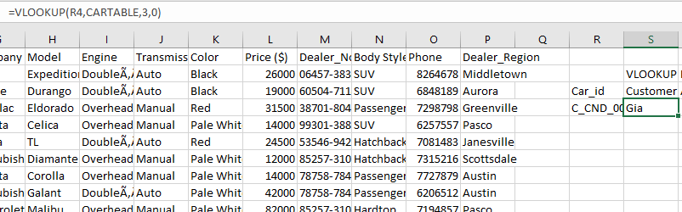
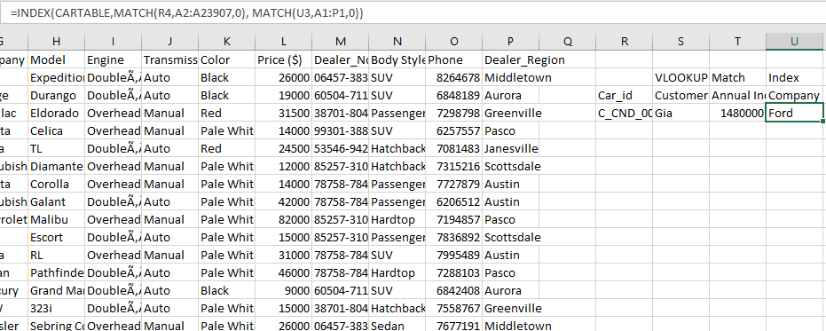

LOOKUP AND INDEX
DATA VALIDATION
VLOOKUP
=VLOOKUP(R4,CARTABLE,3,0)
INDEX
=INDEX(CARTABLE,MATCH(R4,A2:A23907,0), MATCH(U3,A1:P1,0))

Slide 5
Business Questions
9. Colour the cell with green icon where the customer’s annual income is higher than average, otherwise highlight the cell with Yellow icon.
10. Highlight the cell where body style is SUV
11. Highlight the top 10% of sales
12. Highlight the sales where price is greater than average price

Slide 6
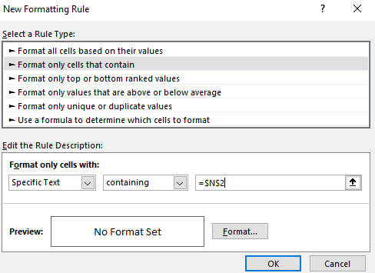
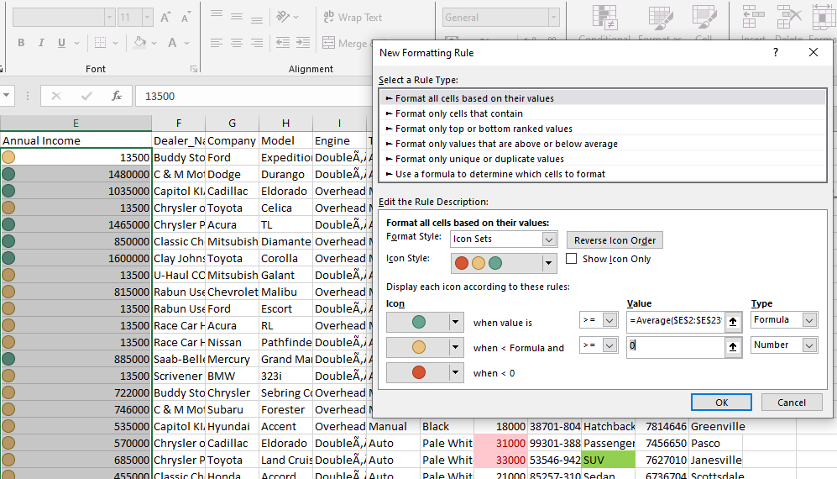
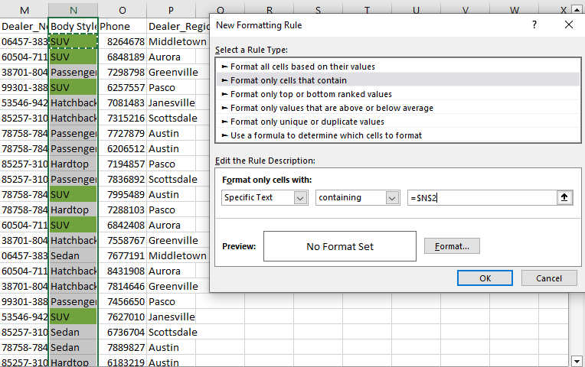
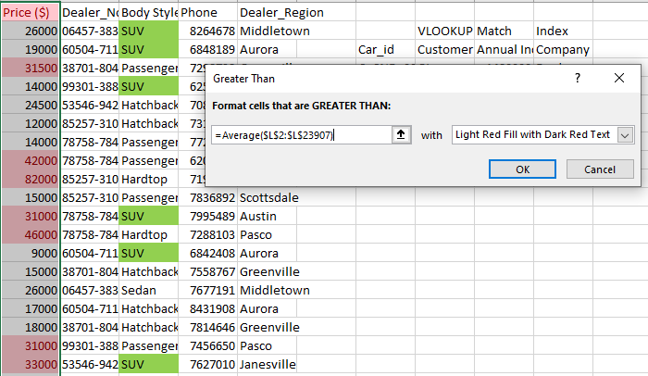
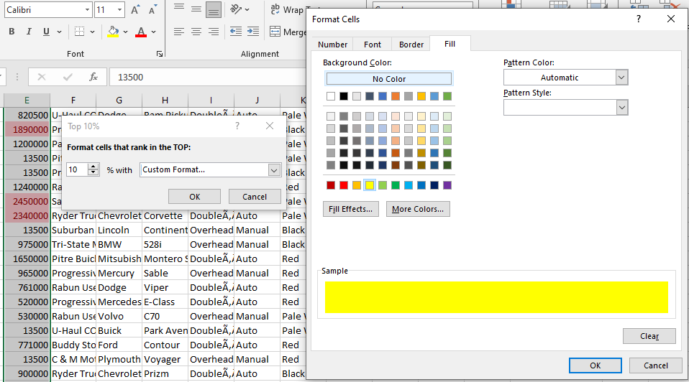
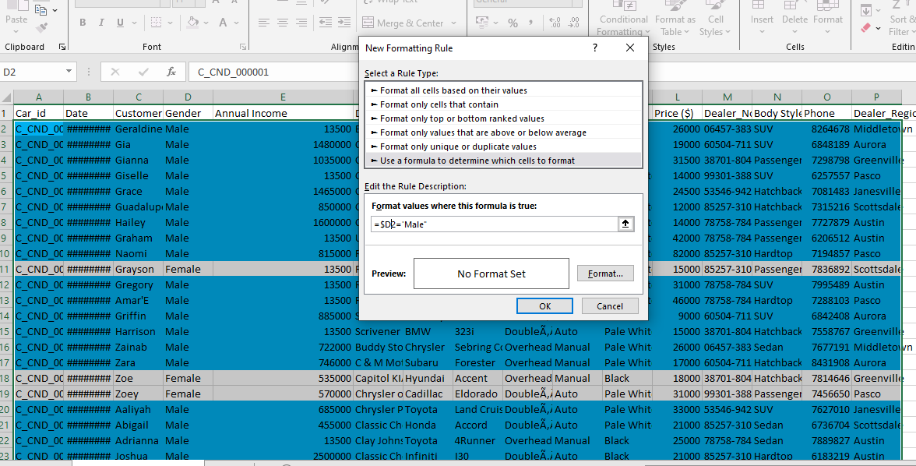
CONDITIONAL FORMATTING

Slide 7
THANK YOU

